Slide 1
Module 7
Multi-modal interfaces and artificial intelligence on AWS
Notes:
Đa tương tác và dịch vụ AI trên AWS

Slide 2
Module 7 Agenda
Last time, on DevAx::academy
Adding multiple modalities to your applications with Amazon AI services – Amazon Polly, Amazon Lex, Amazon Rekognition
Demonstrations of real-world AI integration with apps
The final interation of TravelBuddy – SPA, microservices, serverless, polyglot and chatbot!
Notes:
Tuần trước
Add them khả năng đa tương tác với các dịch vụ AI của AWS
Polly , Lex , Rekognition.
Làm lab , giả lập khả năng tích hợp dịch vụ AI vs ứng dung
Final version của MVP travel buddy – SPA , microservices, severless ,polygot đa hình , và cha t bot

Slide 3

Last time on
DevAx
academy
Serverless SPAs on AWS
Amazon API Gateway
Amazon Cognito
AWS Lambda
Debugging and traceability with AWS X-Ray

Slide 4



Intelligent Multimodal Interfaces
Notes:
Đa tương tác ko chỉ tập trung vào làm việc trên giao diện web hay mobile
Mà cho phép add them khả năng như ra lệnh bang going nói , nhận diện khuôn mặt …

Slide 5
The power of speech
with Amazon Polly

Slide 6
What is Amazon Polly?
A service that converts text into life-like speech
Offers dozens of life-like voices across a variety of languages
Low-latency responses enable developers to build real-time systems
Developers can store, replay, repurpose and distribute generated speech
Notes:
Giới thiệu về Polly
Dịch vụ cho phép convert text to speech
Hỗ trợ đa dạng going nói và nhiều ngôn ngữ , tiếc là chưa hỗ trợ tiếng Việt.
Độ trễ thấp , cho phép developer xây dung hệ thống tương tác real time
Các nhà phát triển có thể lưu trữ , tái sử dung các đoạn hội thoại đc sinh ra.

Slide 7

Amazon Polly: Quality
Natural-sounding speech
A subjective measure of how close TTS output is to human speech.
Accurate text processing
Ability of the system to interpret common text formats such as abbreviations, numerical sequences, homographs etc.
Today in Sydney Australia, it's 26°C
It’s nice to know, we’re going to Nice
Highly intelligible
A measure of how comprehensible speech is.
Peter Piper picked a peck of pickled peppers
Notes:
Today in Sydney Australia, it's 26 degrees C
It's nice to know, we're going to Nice.
Peter Piper picked a peck of pickled peppers.
Chúng ta có thể nghe thử một số đoạn hội thoại của Amazon Polly

Slide 8
Amazon Polly: SSML
Speech Synthesis Markup Language is a W3C recommendation, an XML-based markup language for speech synthesis applications
<speak>
My name is Adam Larter. It is spelled
<prosody rate='x-slow'>
<say-as interpret-as="characters">Larter</say-as>
</prosody>
</speak>
Notes:
Chúng ta có thể dùng file mô tả dưới format SSML
, một dạng format mô tả tiêu chuẩn dành cho các ứng dụng tổng hợp giọng nói.
Cấu trúc cũng ko quá phức tạp.

Slide 9
Amazon Polly: SSML
Speech Synthesis Markup Language is a W3C recommendation, an XML-based markup language for speech synthesis applications
<speak>
This is normal voice,
<amazon:effect name="whispered">
and this is me whispering!
</amazon:effect>
</speak>
Notes:
Nói giọng thường và thì thầm mùa xuân

Slide 10
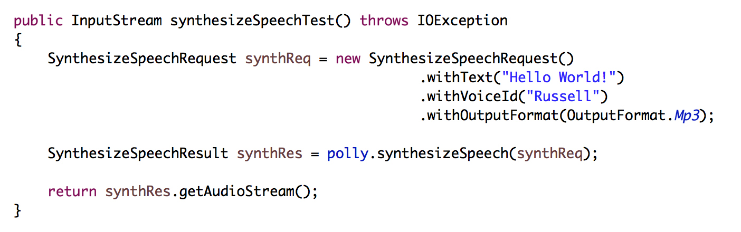
Speech synthesis from Java
Notes:
Chúng ta có thể gọi trức tiếp polly từ SDK , trên đây là vi dụ sử dung Java SDK.
Tạo một yêu cầu tổng hợp going nói , thông tin truyền vào là nội dung và id của going nói. Out put đầu ra là file mp3 tổng hợp.
aws polly synthesize-speech --region us-east-1 --output-format mp3 --voice-id Russell --text "hello dev day nerds, this is a test" test.mpg; mpg123 -q test.mpg
Then run again to look at the visemes:
aws polly synthesize-speech --region us-east-1 --output-format "json" --voice-id Russell --speech-mark-types "viseme" "word" --text "hello dev day nerds, this is a test" out.json; vi out.json

Slide 11
Speech synthesis from the AWS CLI
aws polly synthesize-speech
--region us-east-1
--output-format mp3
--voice-id Nicole
--text ”Text to say" audiofile.mp3
Notes:
aws polly synthesize-speech --region us-east-1 --output-format mp3 --voice-id Nicole --text "Text to say" audiofile.mp3
Tổng hợp và trả kết quả từ AWS CLI luôn

Slide 12
Speech synthesis from the AWS CLI
aws polly synthesize-speech
--region us-east-1
--output-format json
--voice-id Russell
--speech-mark-types "viseme" "word"
--text "Hello this is a a test" test.json
Notes:
Trả về giá trị khẩu hình theo từng từ , vai zờ meis.
Mỗi ngôn ngữ có giá trị khẩu hình khác nhau theo từng từ .
Then run again to look at the visemes:
aws polly synthesize-speech --region us-east-1 --output-format "json" --voice-id Russell --speech-mark-types "viseme" "word" --text "hello this is a test" out.json; vi out.json

Slide 13
Speech synthesis speech markers
{"time":6,"type":"word","start":0,"end":5,"value":"hello"}
{"time":6,"type":"viseme","value":"k"}
{"time":43,"type":"viseme","value":"@"}
{"time":77,"type":"viseme","value":"t"}
{"time":157,"type":"viseme","value":"@"}
{"time":302,"type":"word","start":6,"end":9,"value":"this"}
{"time":302,"type":"viseme","value":"k"}
{"time":385,"type":"viseme","value":"i"}
{"time":423,"type":"viseme","value":"s"}
{"time":501,"type":"word","start":10,"end":12,"value":"is"}
{"time":501,"type":"viseme","value":"i"}
{"time":573,"type":"viseme","value":"s"}
Notes:
Then run again to look at the visemes:
aws polly synthesize-speech --region us-east-1 --output-format "json" --voice-id Russell --speech-mark-types "viseme" "word" --text "hello dev day nerds, this is a test" out.json; vi out.json

Slide 14
The power of sight
with Amazon Rekognition

Slide 15

Images – Another untapped interface
Notes:
Ko thể phủ nhận sự quan trọng trong việc tương tác bang nhiều Phuong thức khác nhau
Ngay trong my vib cũng có check face
Hoặc capture thông tin thẻ , cmnd , giúp người dung đăng ký nhanh.
Traditional interfaces for applications have been dominated by tactile interfaces. What I mean by this is when we interact with applications to help them understand our needs, we provide input using a keyboard, or a mouse or through touch.
This is a very different model to how we, as humans, interact and most importantly, understand, the world around us. Right now, you’re hearing my voice, which is providing one input, but you’re also using your eyes to gather information. You can see the slides up on the screen, and you can see me up here walking around. From this interface, you can gather a lot of information that is not conveyed my speech. You can see that I’m slightly terrified, but you can also see that I’m wearing an Amazon shirt. You can also tell that I’m male and hopefully on the right side of middle aged. Hopefully I also seem pretty excited to be here. All of this information is conveyed through the visual medium.
So as our second multimodal interface for applications, I’ll now take you through Amazon Rekognition.

Slide 16
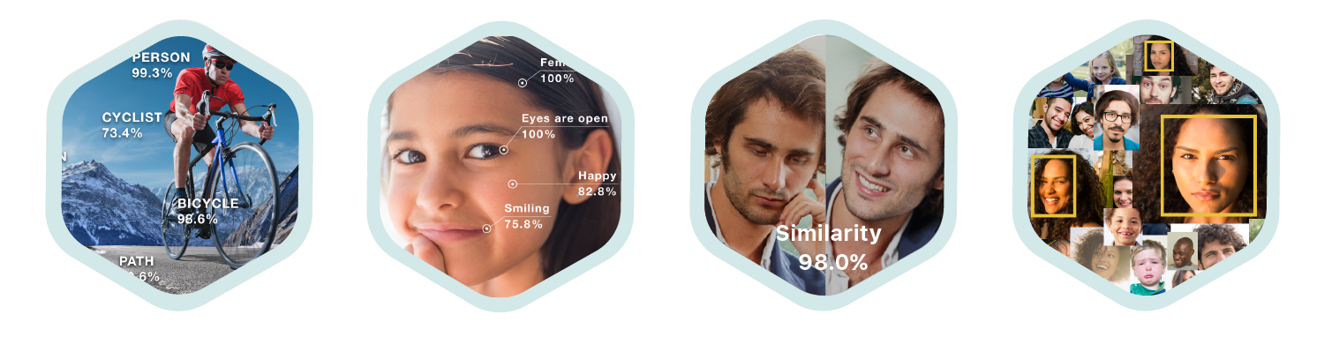
Amazon Rekognition
Deep learning-based image recognition service
Search, verify, and organize millions of images
Object and Scene
Detection
Facial
Analysis
Face
Comparison
Facial
Recognition
Notes:
Một số trường hợp sử dung của Rekognition
Phát hiện object và loại object trong khung cảnh
( cho phép add custom model vào )
Phân tích khuôn mặt, so sánh khuôn mặt, nhận diện khuôn mặt
Ứng dung check in , face pass , mua sắm , loyalty , đăng ký. ..

Slide 17
Amazon Rekognition
Deep learning-based image recognition service
Search, verify, and organize millions of images
Object and Scene
Detection
Facial
Analysis
Face
Comparison
Facial
Recognition

Slide 18

Amazon Rekognition
Object & scene detection
{
"Confidence": 94.62968444824219,
"Name": "adventure"
},
{
"Confidence": 94.62968444824219,
"Name": "boat"
},
{
"Confidence": 94.62968444824219,
"Name": "rafting"
},
. . .
DetectLabels
Notes:
Kết quả trả về dạng json, danh sách object và độ confidence ( tự tin đúng )
Dĩ nhiên có hỗ trợ bounding box , khoanh vùng đối tượng

Slide 19

Amazon Rekognition
Object & scene detection
Indoors
Flower
Coffee Table
Chair
Living Room
Notes:
Ví dụ.:

Slide 20

Amazon Rekognition
Object & scene detection
Maple
Villa
Tree
Plant
Backyard
Potted Plant
Garden
Water
Swimming Pool

Slide 21
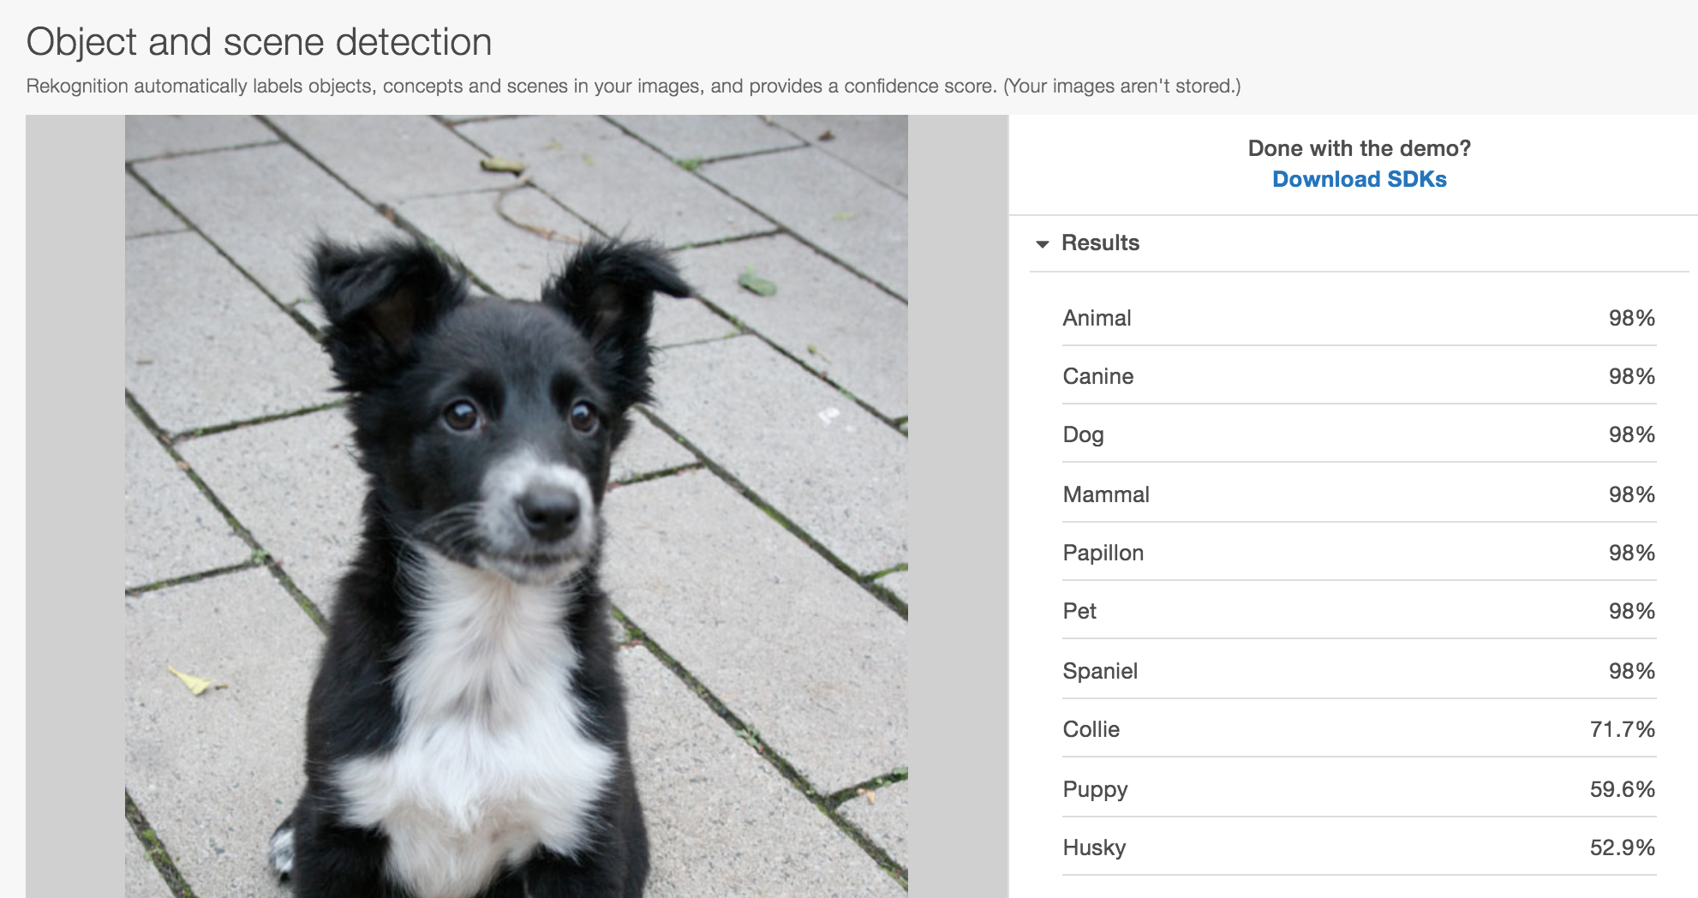
Amazon Rekognition
Object & scene detection

Slide 22

Amazon Rekognition
Object & scene detection use cases
Photo-sharing apps can power smart searches and quickly find cherished memories, such as weddings, hiking, or sunsets.
Vacation rental markets can automatically label host-uploaded images with tags, such as fireplace, kitchen, or swimming pool.
Travel sites and forums can classify user generated images with labels such as beach, camping, or mountains.
Notes:
Một số use case tham khảo cho Rekognition.
Tính năng tìm kiếm thông minh , dựa trên gán nhãn chủ đề cho hình ảnh 1 cách tự động
Tự gán tag hình ảnh được upload

Slide 23






Amazon Rekognition
Example: Property Search
Mobile app
Amazon S3
Lambda
Detect objects & scenes
1. User captures an image for their property
2. The mobile app uploads the new image to S3
3. A lambda function is
triggered and calls Amazon Rekognition
4. Rekognition retrieves the
image from S3 and returns labels for the detected property and amenities
Property search
Amazon Elasticsearch
6. Other users can search
for and view the property
5. Lambda also pushes the labels
and confidence into Elasticsearch
Notes:
Ví dụ tìm kiếm theo thuộc tính
Hình ảnh up lên S3 , lambda gọi recognition xong store kết quả vào elastic search
Client search kq nhanh chóng từ elastic search

Slide 24
Amazon Rekognition
Deep learning-based image recognition service
Search, verify, and organize millions of images
Object and Scene
Detection
Facial
Analysis
Face
Comparison
Facial
Recognition
Notes:
Ok, now let’s talk about….

Slide 25
Amazon Rekognition
Deep learning-based image recognition service
Search, verify, and organize millions of images
Object and Scene
Detection
Facial
Analysis
Face
Comparison
Facial
Recognition
Notes:
….Face analysis…

Slide 26

Amazon Rekognition
Facial analysis
[
{
"BoundingBox": {
"Height": 0.3449999988079071,
"Left": 0.09666666388511658,
"Top": 0.27166667580604553,
"Width": 0.23000000417232513
},
"Confidence": 100,
"Emotions": [
{"Confidence": 99.1335220336914,
"Type": "HAPPY" },
{"Confidence": 3.3275485038757324,
"Type": "CALM"},
{"Confidence": 0.31517744064331055,
"Type": "SAD"}
],
"Eyeglasses": {"Confidence": 99.8050537109375,
"Value": false},
"EyesOpen": {Confidence": 99.99979400634766,
"Value": true},
"Gender": {"Confidence": 100,
"Value": "Female”}
DetectFaces
Notes:
Nhận diện khuôn mặt sẽ trả về dạng json kèm bounding box mặc định
Ngoài ra còn kèm them các yếu tố khác như , đeo kính , mở mắt , giới tính , cảm xúc…

Slide 27
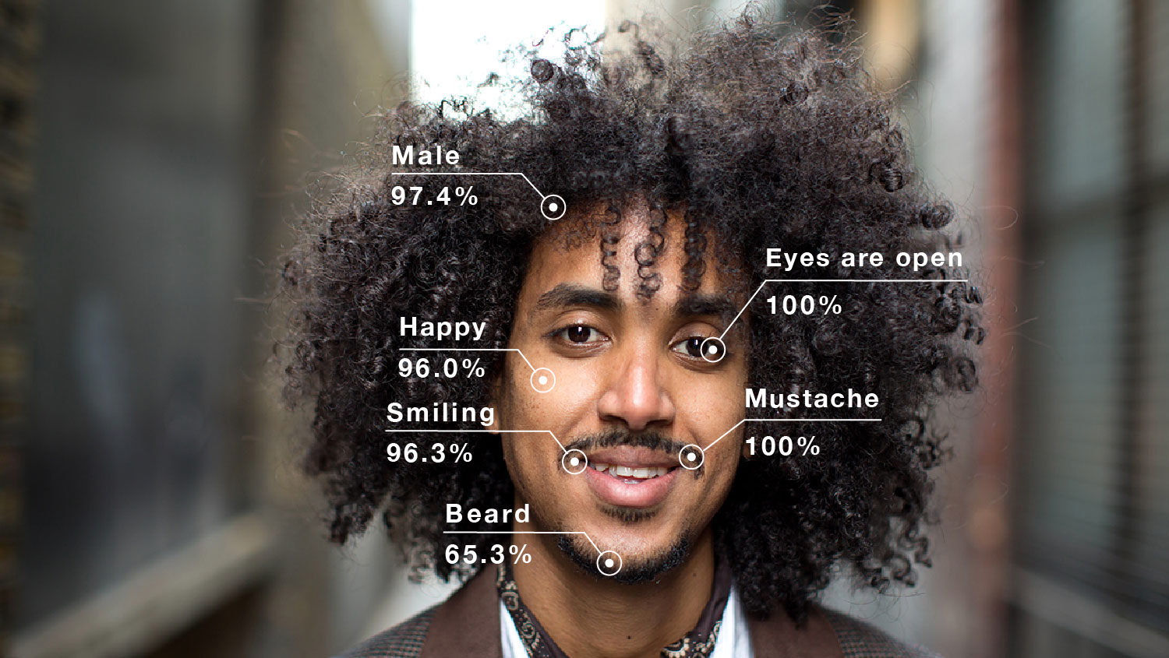
Amazon Rekognition
Facial analysis
Demographic Data
Sentiment Expressed
Facial Landmarks
General Attributes
Image Quality
Notes:
Ví dụ thông tin trả về có thể giúp chúng ta xác định được thái độ , giới tính , chat lượng hình ảnh …

Slide 28


Amazon Rekognition
Use case: Facial analysis - sentiment
Female
Male
Female
Happy
Happy
Sad
Smiling
No Facial Hair
No Eyeglasses

Slide 29
Amazon Rekognition Example Use Case
Anonymous crowd sentiment and location detection – People Plotter
Notes:
How could we use Amazon Rekognition to create a real-world application?
Imagine you wanted to track the movement of people – foot traffic – in a public area?
Use case thực tế , theo dõi chuyển động , đi lại giữa khu vực public

Slide 30
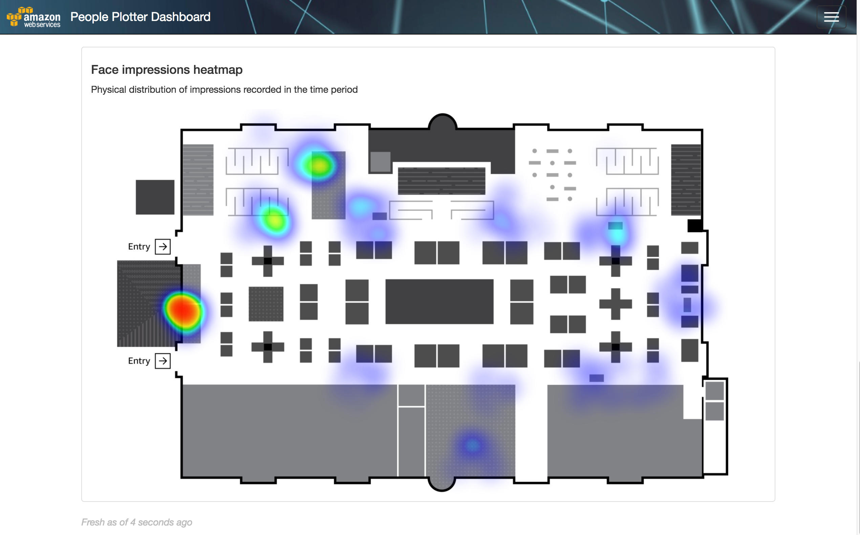
Notes:
Đội prototype team build 1 hệ thống , tracking bản đồ những nơi người đi qua lại nhiều,
In this experiment, we built such a system. Here’s the floorplan. It shows a heatmap of the density of foot traffic at a particular time of the day. The way we implemented this, was by deploying 13 or so cameras in the area, each capturing images and then passing them to Amazon Rekognition to count the number of faces in the image – and also keeping track of the unique faces it detected. We don’t know WHO the faces are, we just know if they are unique.
We call this, the PEOPLE PLOTTER

Slide 31
Notes:
Camera khá đơn giản. Sử dung standard webcam, + Rasberry Pi 3.
This is the IoT device we built, consisting of a RPi, and a standard webcam. We placed these around the floorplan
The devices uses their cameras to take regular photos of the crowds moving around the event. This data is fed into Rekognition where we extract interesting demographic information so that we can help to answer important questions like how many people with beards were at the Red Hat booth at 2:35PM on the first day?
Now security and privacy are job zero at AWS, so this is front-of-mind when building a demo like this. The first thing to keep in mind is this has been built just for fun. The data collected is anonymized and will be destroyed at the end of the second day. We are using the data to generate heat maps based on the labels that rekognition is able to identify from picking faces in the crowd.
Now in addition, we also have people walking the floor with an optional sign-up form that you can complete to allow us to capture some additional data. If you opt-in with these people, we’ll ask you some trivia questions like what your favourite animal is, and we’ll record this against the face vector we’ve extracted for you. This will allow us to report on some additional attributes, like how many dog lovers attend the Splunk Cloud presentation at 3pm on Thursday?
Once again, this is all in the spirit of fun and the data will be destroyed at the conclusion of the event.
WE NEED PR APPROVAL FOR THIS

Slide 32
People Plotter Architecture
Raspberry Pi’s running NodeJS code
Take a shot with webcam using fswebcam
Resize using imagemagick to reduce computational complexity
Pass through OpenCV to detect presence of a face
If a face is detected, pass to back-end
Notes:
Kiến trúc
Raspberry PI chạy node js code
Chụp hình bang fswebcam. Opensource tool kit quản lý web camera
Giảm size hình bang image magick để tang tốc xử lý
Pass qua Open CV check xem có khuôn mặt hay ko, nếu hình nào cũng gửi recognition thì tiền đâu chịu lổi
Nếu có gửi xuống back end
fswebcam is open source toolkit for handling web camera in linux
imagemagick is an image manipulation utility, open source on linux
OpenCV is an open sourced computer imaging toolkit

Slide 33


People Plotter Architecture
detectFaces()
Amazon API Gateway
DetectFaces InScene
Amazon Rekognition
Bounding boxes for faces returned by Rekognition used to slice up the original scene
Amazon S3
Notes:
Kiến trúc phía back end sẽ ntn

Slide 34

People Plotter Architecture
One SNS notification sent for each face in the scene
Amazon SNS
detectFaces()
Amazon API Gateway
DetectFaces InScene
Amazon Rekognition
Bounding boxes for faces returned by Rekognition used to slice up the original scene
Amazon S3
Notes:
Thông qua api gateway , gọi lambda detect facesinscene > gọi recognition., thông tin bounding box trả về lưu ở S3.
Thông tin cũng đc gửi qua SNS

Slide 35
People Plotter Architecture
FaceId + Detector Location + Timestamp
Capture event
statistics for
visualisation
Amazon ElasticSearch
The same face will result in the same identifying ‘FaceId’ value.
We don’t need to know ‘who’ the person is, just that we have seen their face before.
Amazon SNS
Process DetectedFace
Amazon Rekognition
searchFacesByImage()
Notes:
Tiếp theo từ SNS sẽ trigger 1 lambda function detected face . Kiểm tra xem
Face có từng thấy hay chưa
Nếu chưa -> index face
Nếu rồi -> trả về face id
Xong lưu thông tin face id + location + time stamp.
Vào elastic search tiện cho việc biểu diễn
If we have not seen the face before, we learn it using indexFaces()
If we have seen the face before, we get back the same FaceId
Either way, we add the location, faceId and timestamp to ES for visualisation

Slide 36
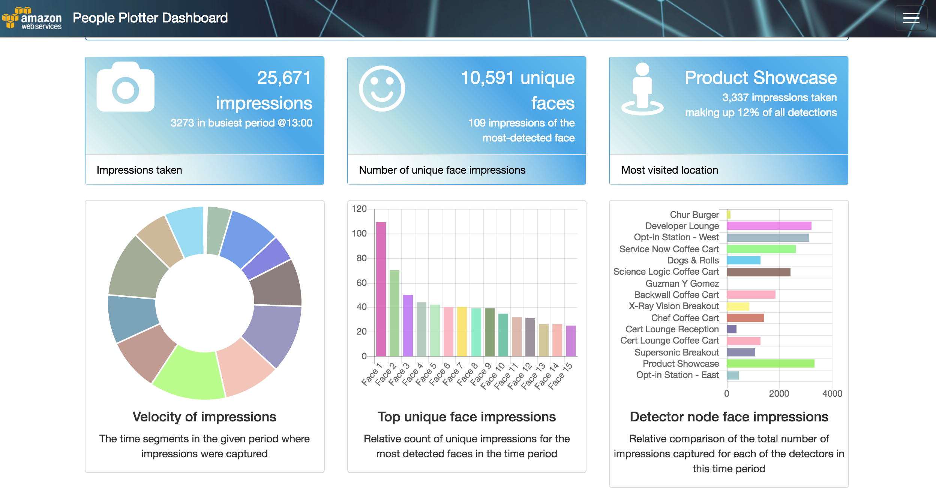
Notes:
Biểu diễn thông tin từ elastic search
Phân tích số lượng , người , thái độ etc

Slide 37
Amazon Rekognition
Deep learning-based image recognition service
Search, verify, and organize millions of images
Object and Scene
Detection
Facial
Analysis
Face
Comparison
Facial
Recognition

Slide 38
Amazon Rekognition
Deep learning-based image recognition service
Search, verify, and organize millions of images
Object and Scene
Detection
Facial
Analysis
Face
Comparison
Facial
Recognition

Slide 39
Amazon Rekognition
Face comparison – face-based identification
CompareFaces
Notes:
So sánh khuôn mặt

Slide 40


Amazon Rekognition
{
"FaceMatches": [
{"Face": {"BoundingBox": {
"Height": 0.2683333456516266,
"Left": 0.5099999904632568,
"Top": 0.1783333271741867,
"Width": 0.17888888716697693},
"Confidence": 99.99845123291016},
"Similarity": 96
},
{
"Face": {"BoundingBox": {
"Height": 0.2383333295583725,
"Left": 0.6233333349227905,
"Top": 0.3016666769981384,
"Width": 0.15888889133930206},
"Confidence": 99.71249389648438},
"Similarity": 0
}
],
"SourceImageFace": {"BoundingBox": {
"Height": 0.23983436822891235,
"Left": 0.28333333134651184,
"Top": 0.351423978805542,
"Width": 0.1599999964237213},
"Confidence": 99.99344635009766}
}
Face comparison – face-based identification
CompareFaces

Slide 41
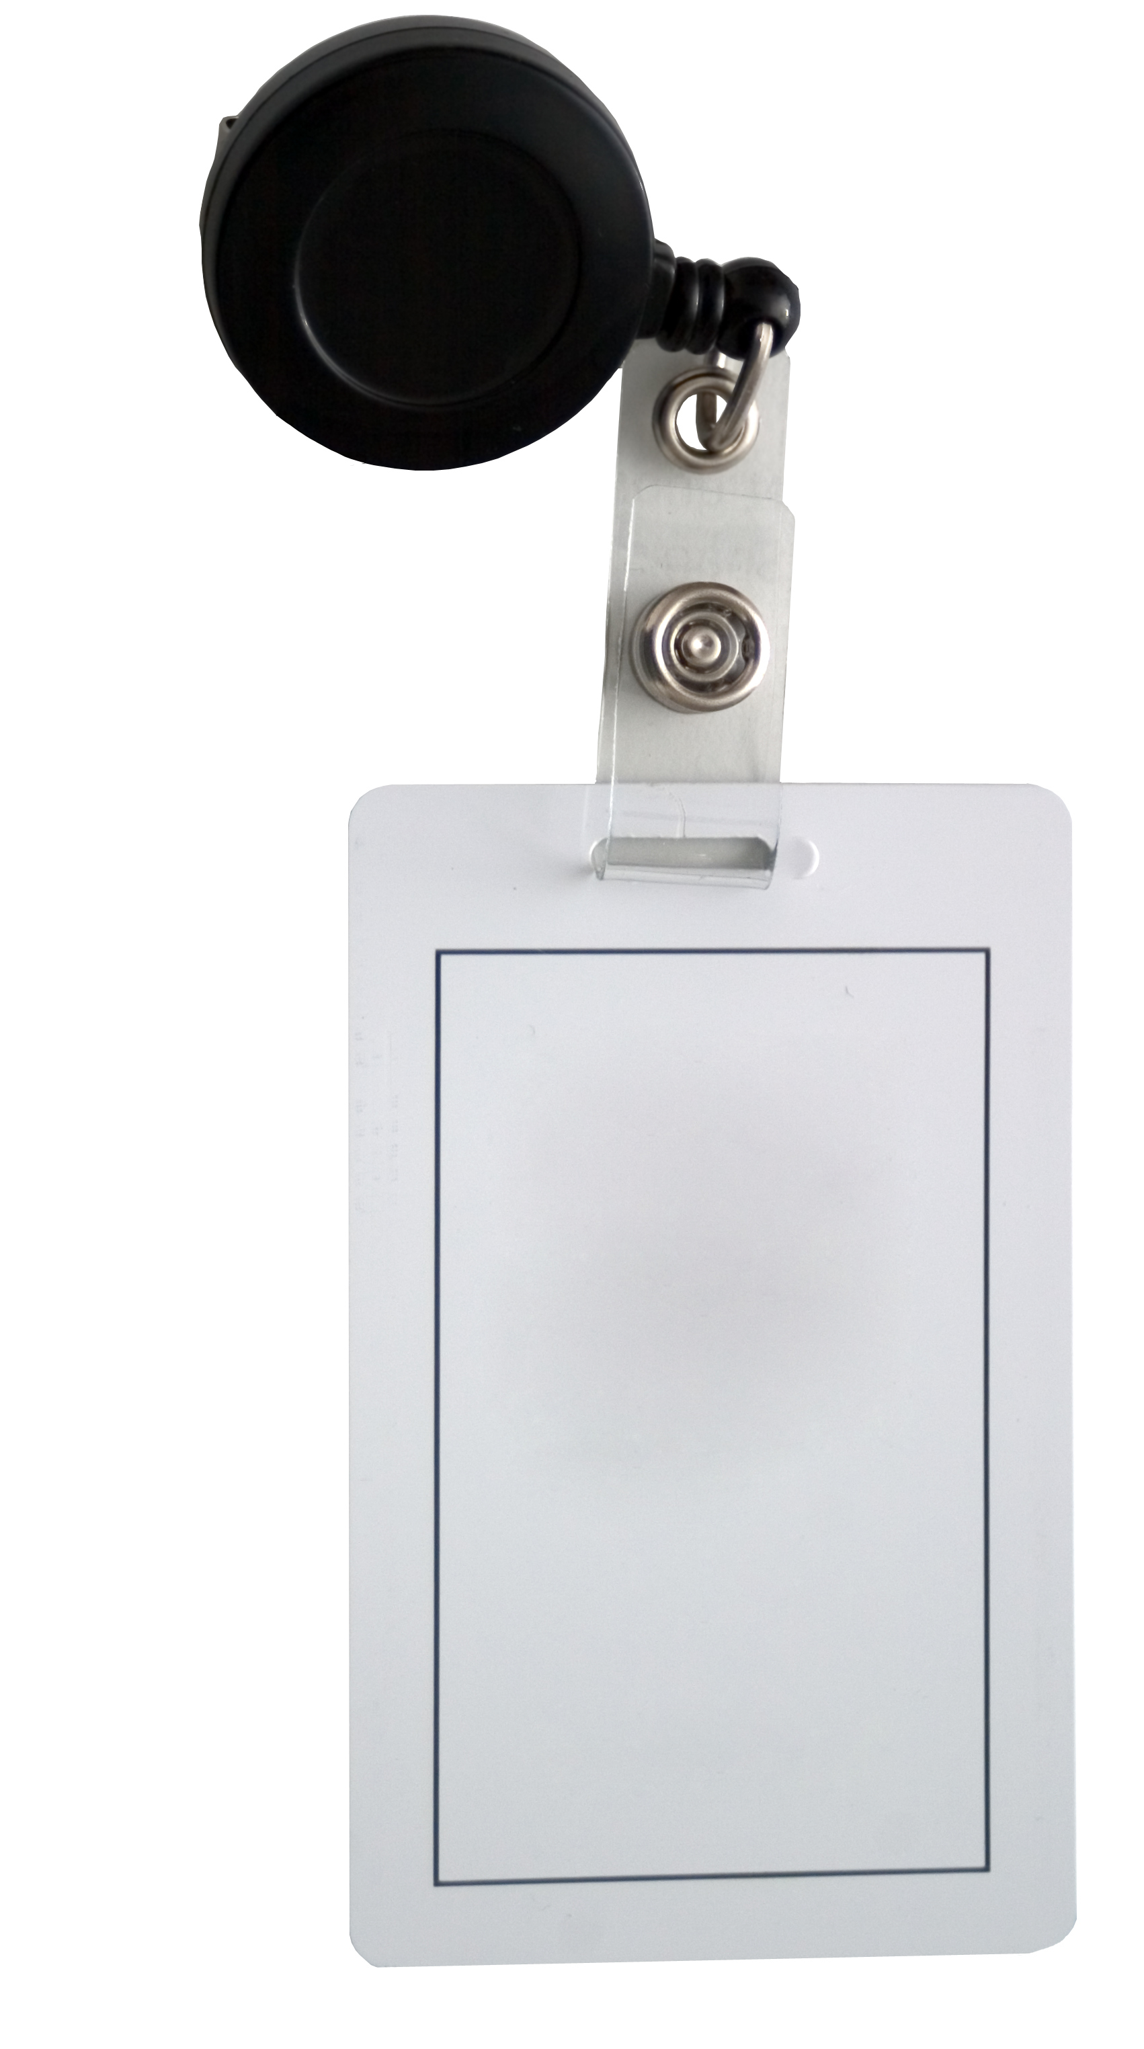


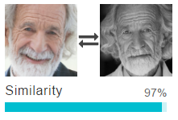
Amazon Rekognition
Face comparison – face-based identification
IoT and camera manufacturers can integrate face-based verification directly into their products
Application of face comparison in locating person of interest for Public Safety
Hotels & hospitality businesses can provide seamless access for guests and VIPs
Online exams or polls can verify presence of registered person by comparing against image captured by webcam.
johnf
Notes:
Tích hợp tính năng nhận diện so sánh khuôn mặt, làm điểm danh
Tìm kiếm 1 người cụ thể trong hình ảnh
Xác định khánh VIP
Kiểm tra cho online exam…

Slide 42
Amazon Rekognition Example Use Case
Authentication using face image
Notes:
Use case - chứng thực sử dung hình ảnh khuôn mặt

Slide 43
Sign In Using Face
Cognito User Pools (CUP) as System of Record for users
Create a Developer-Authenticated Identity Provider (IdP) to perform AuthN using Amazon Rekognition
Federate CUP and Developer IdP through Cognito Identity Federation
Make use of the ExternalId feature of Rekognition in the calls: Rekognition::indexFaces() and Rekognition::searchFacesByImage()
Notes:
Chúng ta sử dung cognito User pools làm nơi lưu trữ user
Sau đó sẽ tạo một developer-authenticated identity provider , để thực hiện chứng thực với amazon recognition.
Cấu hình map role vs permission thông qua Cognito identity federation.
Chúng ta sẽ sử dung 1 feature của recognition là external Id , cho phép index các khuôn mặt và tìm kiếm khuôn mặt bang hình
We’re going to make use of a feature of Cognito identity Federation that allows you to link two IdPs together to refer to the same user
We’re also going to take advantage of a feature of Rekog whereby when you ask it to learn a new face you can provide some application-specific metadata – called the externalId – that will be returned back to the applciation if the face is later matched by a lookup using searchFacesByImage()

Slide 44


Link face to Cognito User
Username and password sent to Cognito User Pools Identity Provider
Mobile App
Amazon Cognito User Pool
Notes:
Bước 1 , user gửi user + pass tới congito user pool

Slide 45

Link face to Cognito User
Mobile App
Cognito Identity Token returned
Amazon Cognito User Pool
Notes:
Cognito trả về jwt token

Slide 46

Link face to Cognito User
Store in Collection
Identities linked by SDK call to getOpenIdTokenForDeveloperIdentity()
Amazon Cognito Identity Pool
User’s Face
Image
Cognito Identity Token
+
username
as ExternalId
Rekognition::indexFaces()
Amazon API Gateway
Lambda function
Amazon Rekognition
User’s Face
Image
Cognito User Pool username stored in the Rekognition collection as the ExternalId for the user’s face vector
Mobile App
Notes:
Sau đó gửi jwt + face image tới api gateway - > trigger lambda function -> gửi thông tin tới amazon recognition
Thông tin user nam dc sử dung làm faceid lưu trong recognition collection.

Slide 47
Sign in using face
FaceId + ExternalId
Amazon Cognito Identity Pool
User is authenticated
User’s Face
Image
Amazon API Gateway
Lambda function
Amazon Rekognition
User’s Face
Image
Rekognition::searchFacesByImage()
finds matching faces in the index and returns the ExternalId which allows us to administratively log the user on
Mobile App
Notes:
Tìm mặt bang hình
Nếu match index thì trả về. Lúc đó mới cho phép user logon

Slide 48
Conversational Interfaces with Amazon Lex
Speech
Recognition
Natural Language
Understanding
Powered by the same deep learning technology as Alexa
Notes:
Dịch vụ tiếp theo là amazon lex
Dùng chung công nghệ vs Alexa – nhận diện going nói và xử lý ngôn ngữ tự nhiên
CORE components
Voice input to text
Language understanding is taking that text and working out the intent
Both these power Alexa and Echo that is now a AWS service

Slide 49




Amazon Lex – Use Cases
Informational Bots
Chatbots for everyday consumer requests
News updates
Weather information
Game scores ….
Application Bots
Build powerful interfaces to mobile applications
Book tickets
Order food
Manage bank accounts ….
Enterprise Productivity Bots
Streamline enterprise work activities and improve efficiencies
Check sales numbers
Marketing performance
Inventory status ….
Internet of Things (IoT) Bots
Enable conversational interfaces for device interactions
Wearables
Appliances
Auto ….
Notes:
Các use case cho lex
Chat bot
Application bot
Bot cho ứng dung enterprise
Iot bots.

Slide 50
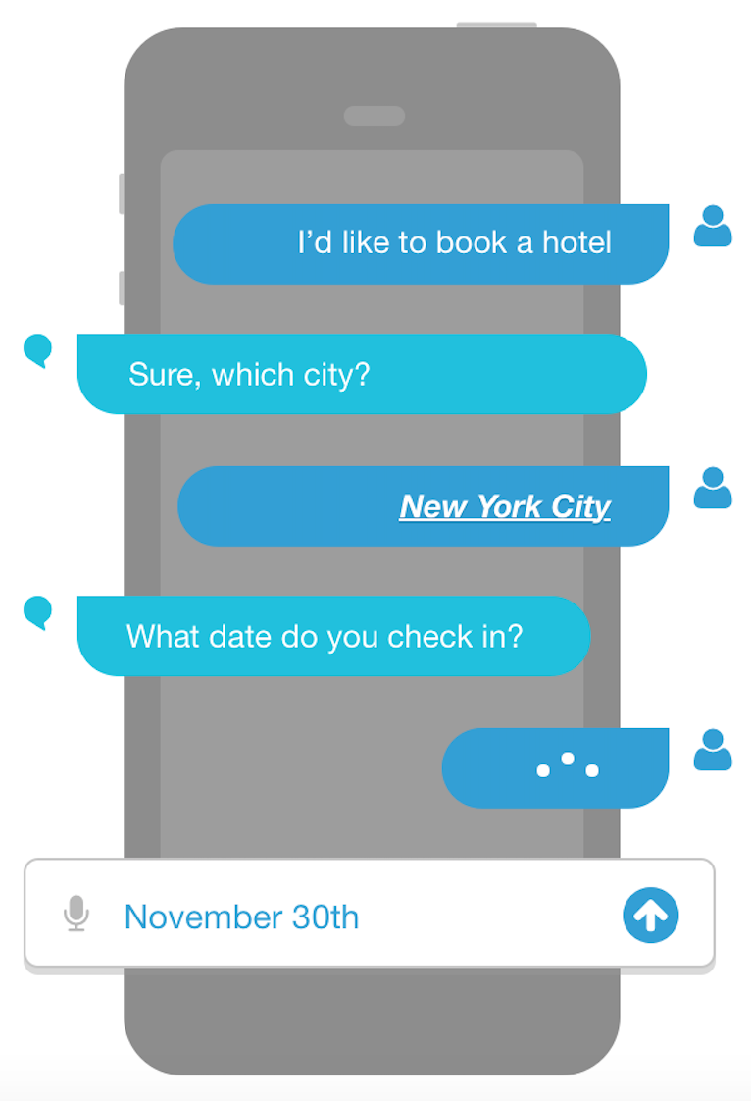
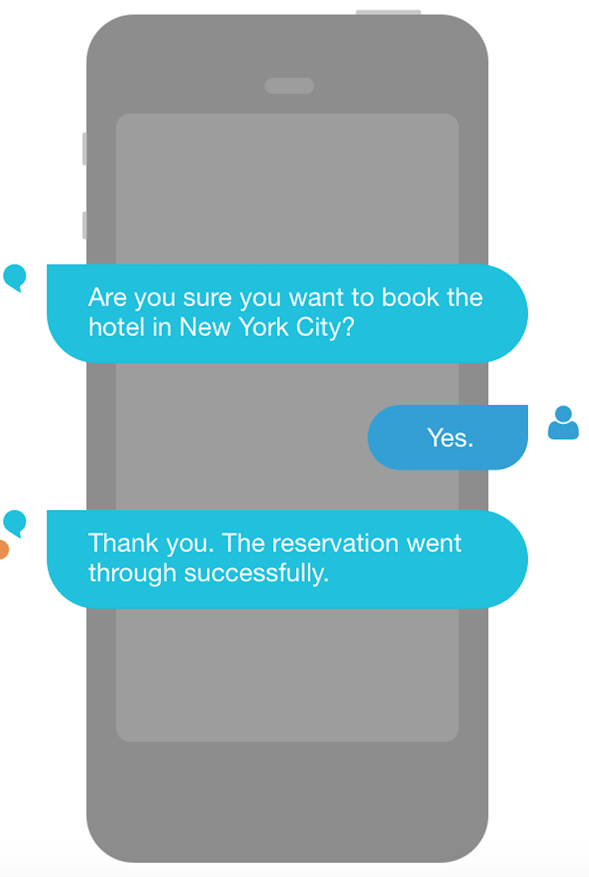
Lex Bot Structure
Intents
An Intent performs an action in response to natural language user input
BookHotel
Utterances
Spoken or typed phrases that invoke your intent
Slots
Slots are input data required to fulfill the intent
Fulfillment
Fulfillment mechanism for your intent
Notes:
Cấu trúc lex bot
Intents – thực hiện 1 tác vụ theo reponse của user
Utterances – đoạn ngôn ngữ có thể trigger intents
Slots – những dữ lieu cần phải đc cấp
Fulfilment : cơ chế thực hiện tác vụ và trả về kết quả , nằm trong 1 intent.

Slide 51
Amazon Lex, Amazon Polly, Amazon Rekognition Example Use Case
The Smart Assistant
Notes:
Use case kết hợp Polly , recognition , lex

Slide 52
Smart Assistant - Key Features
Face detection & face recognition
Face detection with OpenCV http://opencv.org
Face recognition powered by Amazon Rekognition
Hot word detection to get device’s attention
Snowboy https://snowboy.kitt.ai/
Silence detection during live speech capture for start/stop
SoX http://sox.sourceforge.net/
Streaming of audio capture in live-time to reduce latency
AWS IoT
NLU powered by Amazon Lex
Notes:
Trợ lý thông minh
- Các tính năng chính :
- detect và nhận diện khuôn mặt. Rekognition.
- detect hot word để trigger ( công cụ snow boy )
- phát hiện khoảng lặng ( SoX) , công cụ giúp tách các đoạn hội thoại dựa vào khoảng lặng.
- stream audio capture đc thời gian thực để giảm độ trễ , sử dung AWS IoT.
- Tương tác và làm việc bang ngôn ngữ tự nhiên với Amazon Lex

Slide 53
Smart Assistant
START
Wait for Face to appear in camera view
Wait for Hot Word (Snowboy)
Hotword detected
“Eyes Open”
Notes:
Chúng ta cùng đi qua flow của smart assistant app.
Đầu tiên thường chúng ta sẽ ở cơ chế lắng nghe 1 hot word để trigger .
Chờ khuôn mặt hiện ra trong camera

Slide 54
Smart Assistant
Wait for Face to appear in camera view
Recognise Face (Amazon Rekognition)
Capture image from webcam (ffmpeg)
Is the face in the collection?
Run User Speech Dialogue Interaction and NLU
NO
Resize to improve process efficiency
(Imagemagick)
YES
Detect face on device
(OpenCV)
Known User State
Replay Audio
Notes:
Khuôn mặt hiện ra -> capture image -> resize > detect face
-> gọi recognition , face có thì -> user cũ.
Face new -> run các đoạn hội thoại tương tác và NLU *natural language understanding ”

Slide 55
Smart Assistant
Run User Speech Dialogue Interaction and NLU
Listen for speech input with silence detection (SoX)
On Audio Segment Captured –MQTT
(AWS IoT)
Notes:
Chúng ta sẽ xem kiến trúcAWS đằng sau component này

Slide 56


Streaming audio via AWS IoT
Audio streamed in segments in live-time using SoX and stdout pipe
AWS IoT
Segments written to DynamoDB as base64 chunks of audio
Amazon DynamoDB
Notes:
Đầu tiên audio sẽ đc stream realtime sử dung
SoX
Stdout
Segment audio sẽ đc lưu vào dynamodb

Slide 57

Streaming audio via AWS IoT
On silence detected
Amazon API Gateway
ProcessLexDialog
Amazon Lex
Chunks read from DynamoDB and converted to audio segments
Amazon DynamoDB
Notes:
Tiếp theo lambda function lex diaglog sẽ đọc dynamodb và convert lại thành audio segment -> làm việc với LEx

Slide 58
Smart Assistant
Run User Speech Dialogue Interaction and NLU
Listen for speech input with silence detection (SoX)
Listen for speech input with silence detection (SoX)
Is the interaction Ready for Fulfillment?
On Audio Segment Captured –MQTT
(AWS IoT)
Process intent
(API Gateway/Lambda)
YES
On Silence – submit to APIGW base on key
Play audio response & loop back to listen for speech input
NO
Notes:
Tương tác sẵn sàng để thực hiện -> thực thi intent
Ko sẵn sàng -> hỏi và cho nghe lại

Slide 59
Our journey!
DevAx
academy
DevAx
You are now at the end of the curriculum for
Over the past 7 modules, you have taken a monolithic Java application, deployed it to PaaS Elastic Beanstalk without making changes to the code, in order to meet a compelling event deadline
You then introduced CI/CD so that you can streamline your deployment, and experimented with the various automation options available.
You broke your monolithic application up into microservices and made use of serverless (AWS Lambda and AWS API Gateway) to optimise costs and abstract you from infrastructure.
academy
Notes:
Điểm lại 7 tuần qua

Slide 60
Our journey!
DevAx
academy
You extracted parts of your data model into different data storage tiers, making use of Amazon DynamoDB and Amazon RDS.
You then migrated the application to an SPA and secured it with Amazon Cognito.
And finally, you added a chat bot to allow your customers to interact naturally using AI with Amazon Lex.
Along the way, you learned about how to use the AWS SDKs to write real-world applications; you experimented with Amazon Polly and Amazon Rekognition; you learned about the AWS developer tools AWS CodeStar, AWS CodeBuild, AWS CodeDeploy, AWS CodePipeline.
Notes:
Trải nghiệm các dịch vụ DB , AI , Code Pipeline …

Slide 61
Our journey!
DevAx
academy
You used AWS Lambda and Amazon API Gateway together with
Amazon Cognito for a secure, highly-scalable serverless architecture.
You used AWS X-ray for high-visibility to the way your applications
were performing and used AWS Step Functions to manage distributed complexity.
You learned about messaging options on AWS with Amazon SNS, Amazon SQS, Amazon Kinesis and AWS IoT.
You made use of Amazon Elastic Search to visualize high-cadence data ingestion.
You used Windows and Linux EC2 instances and learned how to connect to them and manage them.
Notes:
Sử dung serverless lambda
Protect back end api vs api gateway + cognito
Trace + monitor với aws x-ray
Orchestrate với Step function
Messaging với SNS , SQS , Kinesis, IoT
Sử dung Elastic Search để biễu diễn data.

Slide 62
Our journey!
DevAx
academy
You made extensive use of CloudFormation for software-defined infrastructure and reliable automation.
You worked with Identity and Access Management (IAM) to create secure implementations.
You embraced polyglot and polyglot persistence, and that only relational data belongs in a relational database.
You learned about CQRS and event sourcing on AWS.
You learned how to create highly scalable, reliable, available, secure and automatable systems and applications using the AWS platform.
Notes:
Cloud formation – infra as code nè
IAM bảo mật nè
Tính đa hình nè
Kiến trúc CQRS đọc ghi riêng rẽ nè
Kiến trúc event source. - async processing nè
Kiến trúc sẵn sàng cao nè

Slide 63
Go build something awsome!
Notes:
Tiến lên

Slide 64
Thank you!
Notes:
Thanks you anh em

